Slide 1
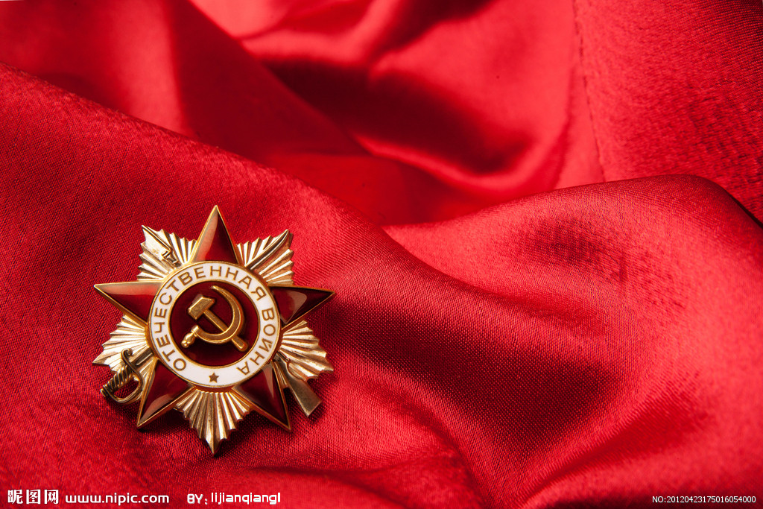
ГОСУДАРСТВЕННОЕ БЮДЖЕТНОЕ ПРОФЕССИОНАЛЬНОЕОБРАЗОВАТЕЛЬНОЕ УЧРЕЖДЕНИЕ
«ТВЕРСКОЙ ПОЛИТЕХНИЧЕСКИЙ КОЛЛЕДЖ»
«Liberation of Kalinin from the Wehrmacht»
Авторы:
Бредов Вадим
Мартынов Максим
Мякенький Игорь
Группа 15
Профессия:
Автомеханик
Руководитель работы: преподаватель английского языка
Афанасьева Анна Викторовна
г. Тверь, 2015

Slide 2
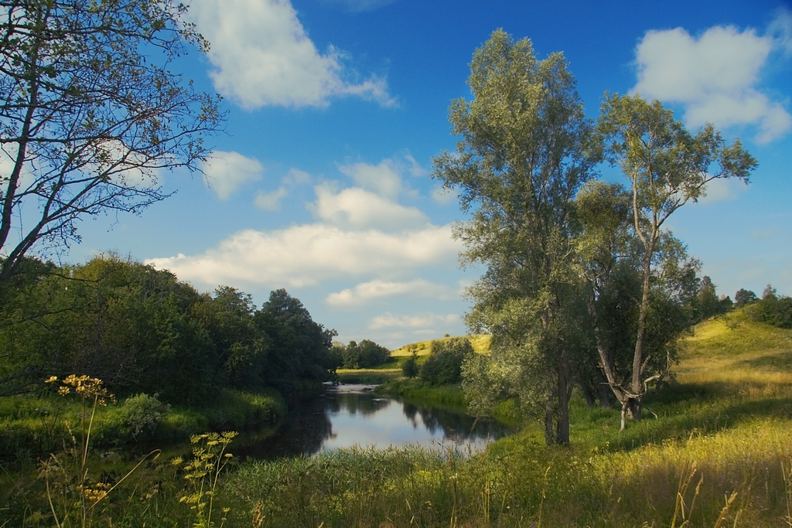
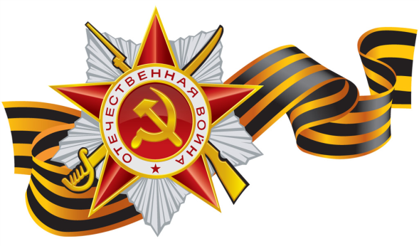
VICTORY IS A COMMON CAUSE!
You – my native land, the paternal land.
You`re my holiday and my shield.
Sun and heart are one in our common breast,
In the Earth inside and in me.
(by Robert Rozhdestvensky)

Slide 3
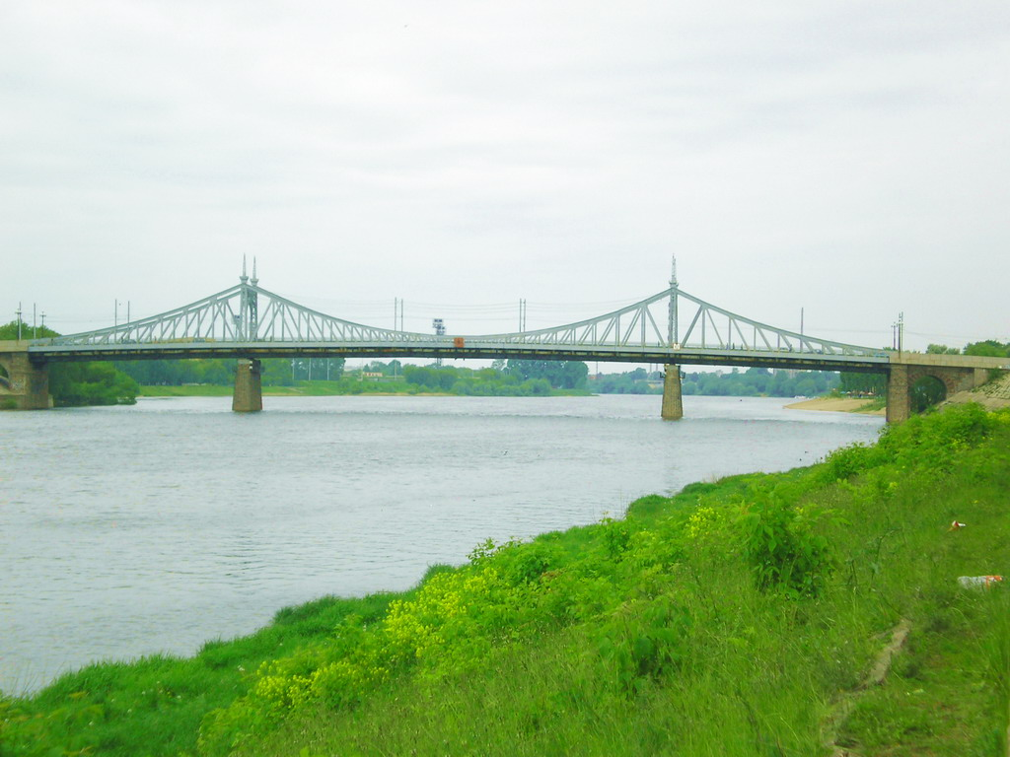
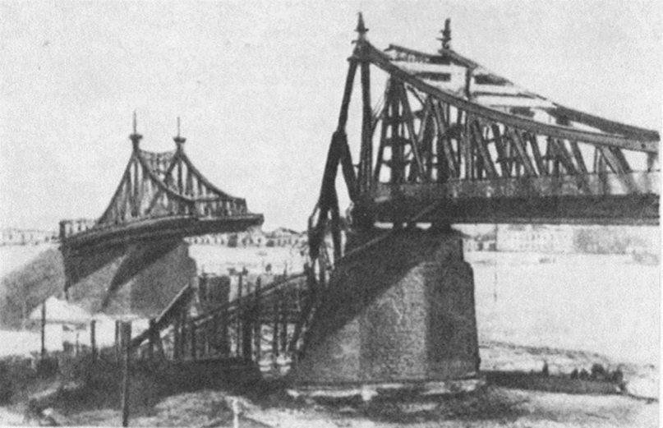
In the history of the Tver land the Great Patriotic war became an important, vibrant and at the same time tragic. Three years on the territory of Tver region, which in those days consisted of 69 districts, passed the front was brutal, bloody battles.

Slide 4
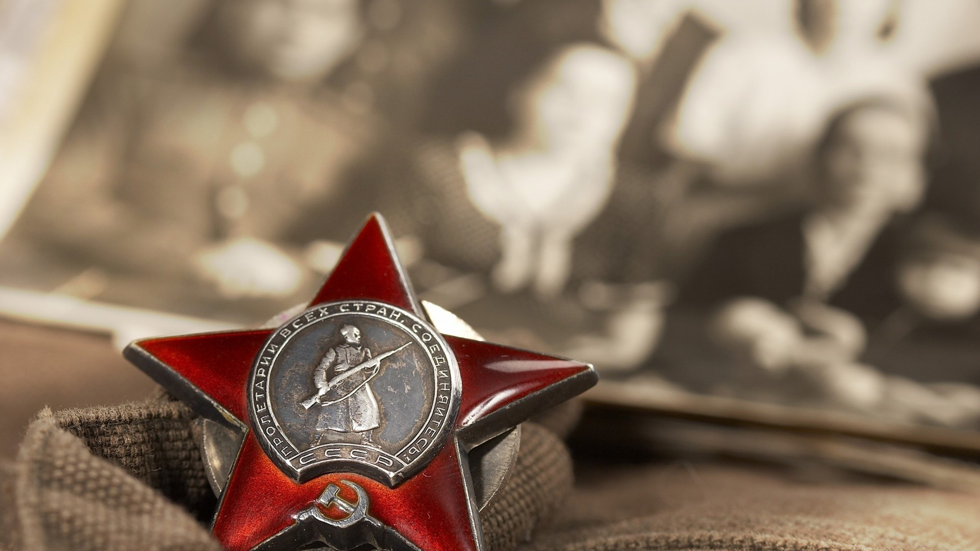
On the territory of Kalinin region were fully formed management 69 rifle corps, 260, 290, 242 shooting divisions.
And the 48th infantry division, stationed in our area was fully equipped of inhabitants of Kalinin .
All of these compounds war marched a long way during the Great Patriotic war.

Slide 5
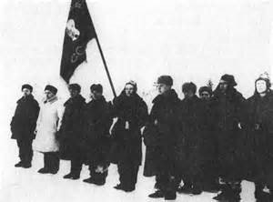
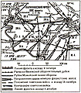
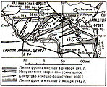
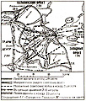
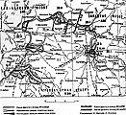
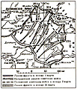
Kalininskaya defensive operation (October 10 - 4 December 1941)
Kalininskaya offensive operation (December 5, 1941 - 7 January 1942)
Rzhev offensive operation
(8 January - April 20, 942)
Toropets -Kholm offensive operation (January 9 - 6 February 1942)
Rzhev-Sychevka offensive operation (30 July - 23 August 1942)
Rzhev-Sychevka offensive operation (25 November - 20 December 1942)
Rzhev offensive operation (2 - 31 March 1943)
On this slide you can see the plans for defensive and offensive operations of the Kalinin front.

Slide 6
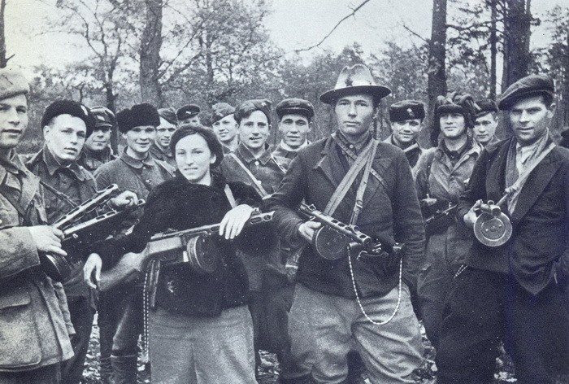
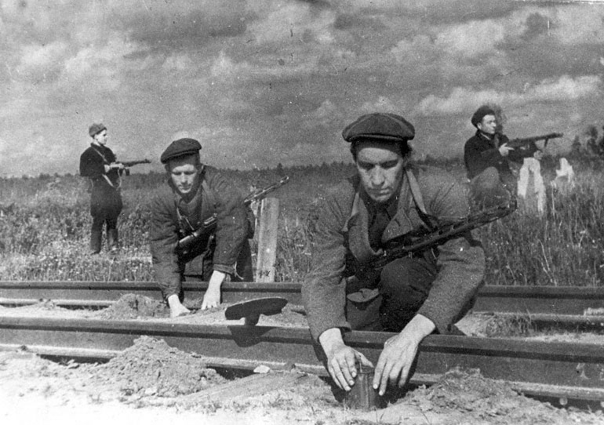
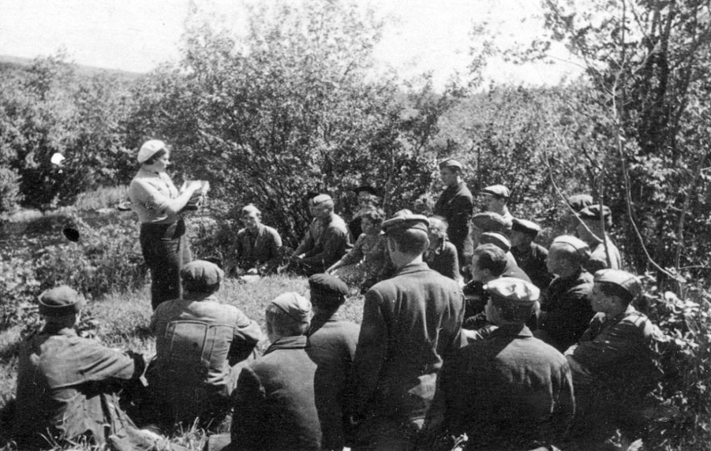
The enormous scale of the occupied territory of the region received the partisan and underground movement.
During 1941-1944 there were 23 partisan brigade, 100 individual units and groups that fought with the enemy about 14 thousand partisans.
They killed tens of thousands of occupants, about 690 trains with military equipment and troops, about 3 thousand cars, 111 warehouses with ammunition and food, 38 tanks. Over 5 thousand Kalininsky partisans were awarded orders and medals.

Slide 7
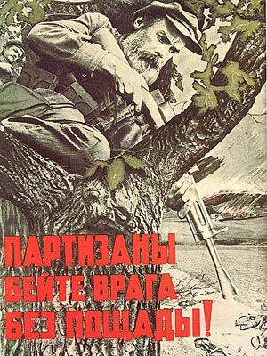
Inna Konstantinova
Throughout the country are known the names of the great patriots who fought in the partisan ranks at the Kalinin Earth and sacrificed their lives for the liberation of the country, - Inna Konstantinova , Tamara Ilyina, Elizabeth Chaikina, Nikolay Goryachev
Nikolay Goryachev
Tamara Ilyina
Elizabeth Chaikina

Slide 8
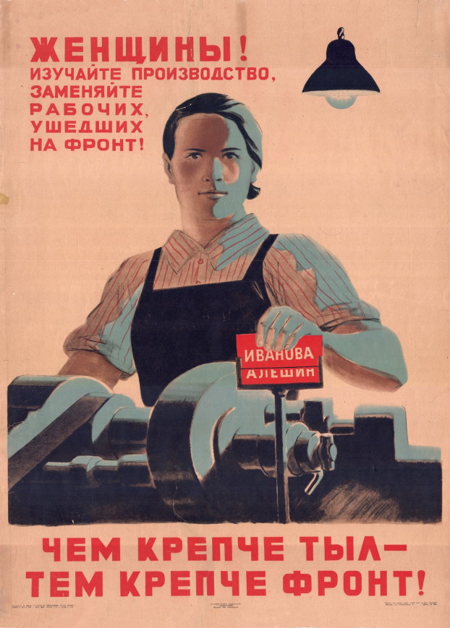
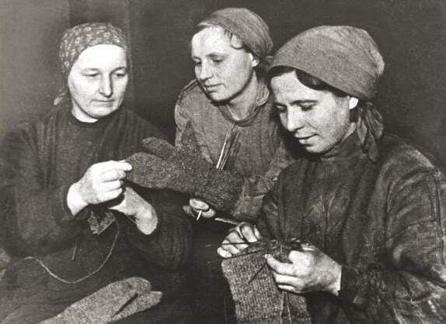
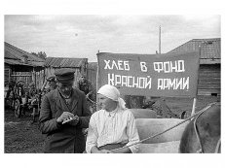
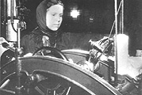
Frontal areas has made its contribution to the overall victory. The residents raised money for the construction of a tank column "Kalinin front. In 1942 72 formed female tractor brigade.
Definitely the harvests were many farms, especially in Bezhetsk and Krasnokholmskiy areas.
In 1944 acreage fields in the area increased by 54 thousand hectares compared to the previous year. In Kimri the factory "Red star" produced during the war, over a million pairs of shoes for the soldiers of the red Army.

Slide 9
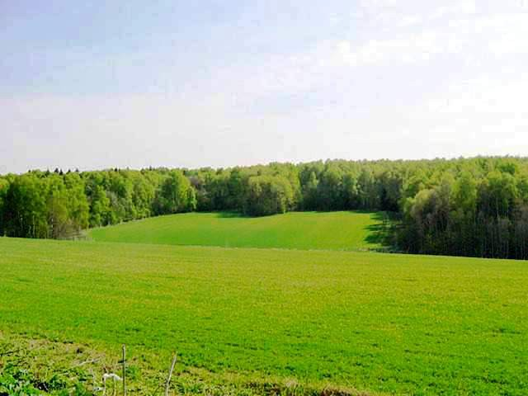
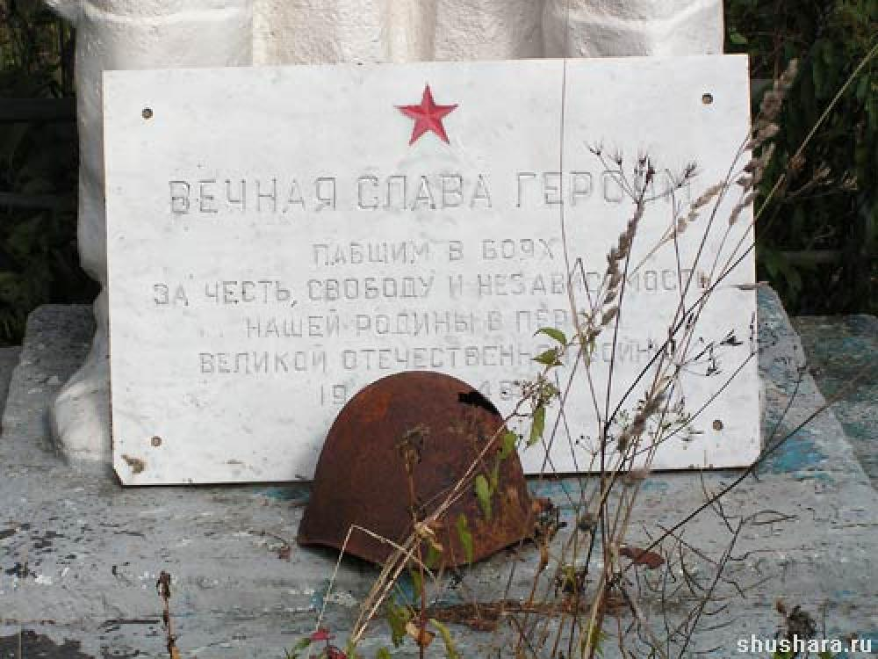
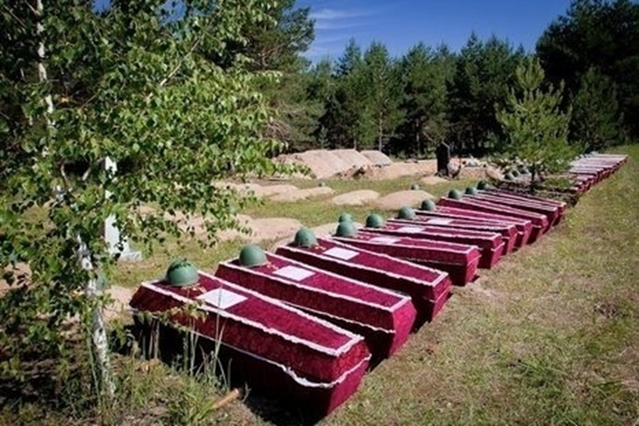
There is a distance great, and without end
Behind a village fence, and in fate.
To you, Earth, I bow lowly, so that
I`m bowing up to your belt.
(by Robert Rozhdestvensky)

