Slide 1
ВНЕКЛАССНОЕ МЕРОПРИЯТИЕ по АНГЛИЙСКОМУ ЯЗЫКУ ИГРА «БРЕЙН -РИНГ» по теме «Моя профессия – моё будущее» «My profession is my future» Преподаватель Английского языка Афанасьева Анна Викторовна ГБП ОУ «Тверской политехнический колледж» г. Тверь, 2016

Slide 2
Цели урока
Познавательная цель:
Совершенствование лексических навыков и навыков чтения, развитие навыков ДР, восприятия речи на слух (по теме Моя профессия - Автомеханик).
Воспитательная цель:
Воспитание интереса к будущей профессии и к изучаемому языку
Развитие творческого отношения к учебной деятельности и к избранной профессии
Развивающая цель :
Развитие умений применять полученные знания в нестандартных условиях
развитие умений грамотно, четко и точно выражать свои мысли

Slide 3
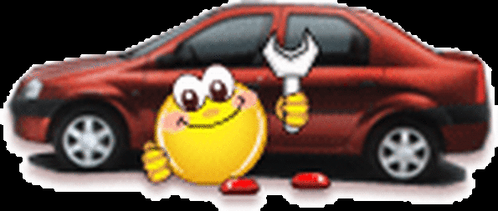
ОТБОРОЧНЫЙ ТУР
The elimination round

Slide 4
Make a word / Составь слово
1. r, c, a
car
автомобиль
2. t, o, m, o, r
motor
мотор
3. l, g, t, i, s, h
lights
светофор

Slide 5
Make a word / Составь слово
4. v, e, r, d, r, i
driver
водитель
5. r, d, o, a, s, i, e, d
roadside
обочина
6. b, a, r, e k
brake
тормоз

Slide 6
Make a word / Составь слово
7. w, y, a
way
путь
8. s, t, t, e, e, r
street
улица
9. r, o, d, a
road
дорога

Slide 7
Make a word / Составь слово
10. l, g, h,, t, i, h, a, e, d
headlight
фара
11. r, o, s, c, s, r, a, o, d, s
crossroads
перекресток
12. h, i, h, g, w, y, a
highway
магистраль

Slide 8
Make a word / Составь слово
13. h, n, a, d / b, a, r, k, e
hand brake
ручной тормоз
14. t, a, r, f, f, c, i, / s, g, n, i
traffic sign
знак дорожного движения
15. s, d, i, e, w, l, a, k
sidewalk
тротуар, пешеходная дорожка

Slide 9
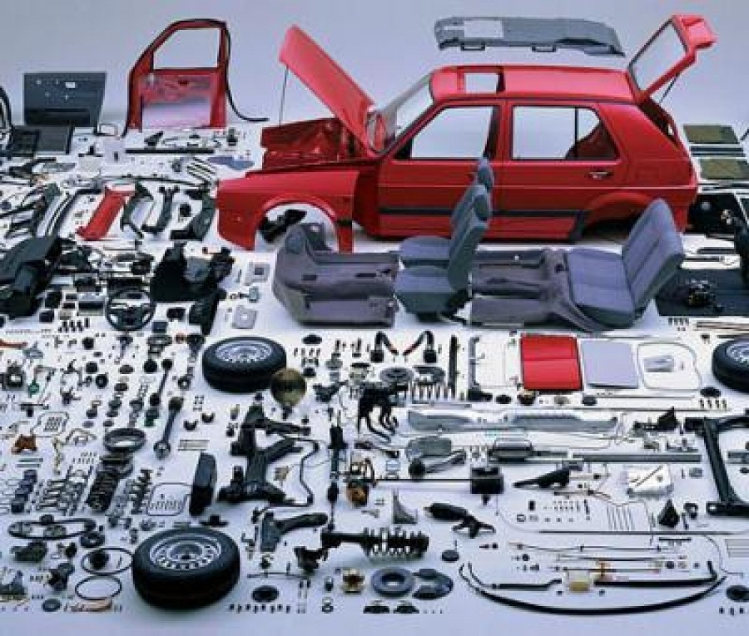
The first round Call the part of the car.

Slide 10
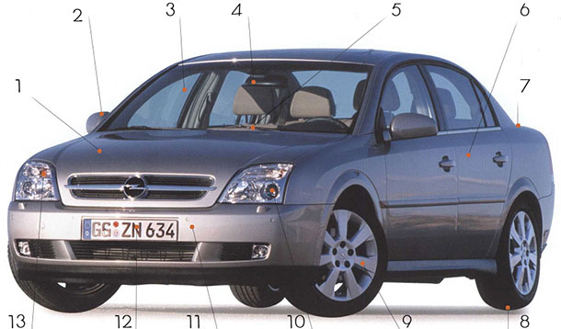
1. Bonnet – капот 2. Wing mirror – боковое зеркало 3. Windscreen – лобовое стекло 4.Rear-view mirror – зеркало заднего вида 5. Windscreen wiper – «дворник» 6. Door – дверь 7. Boot – багажник 8. Tire – шина 9. Wheel – колесо 10. Headlight – фара 11. Bumper – бампер 12. License plate – номерной знак 13. Indicator – указатель поворота

Slide 11
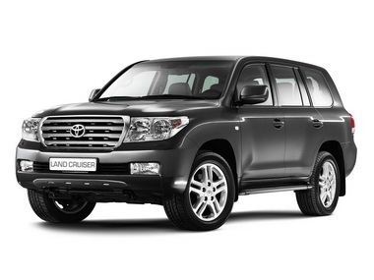
Question №1
An official sign on the front and back of a motor vehicle, with numbers and letters.
1. License plate
2. Headlight
3. Bonnet

Slide 12
Question №2
A long thin tool that moves across a vehicle's windscreen to clear the rain off it.
1. Rearview mirror
2. Wiper
3. Headlight

Slide 13
Question №3
A thick rubber cover that fits round the wheel of a bicycle, car, or other vehicle.
1. Tire
3. Wiper
4. Bonnet

Slide 14
Question №4
The front part of a car that covers the engine.
1. Bonnet
2. Boot
3. Tire

Slide 15
Question №5
The part of a door or window that you use for opening it.
1. Handle
2. Armrest
3. Dashboard

Slide 16
The second round Make the dialogue.

Slide 17
- Thank you.
- OK. Please, drive your car into the garage… Let me check the car and diagnose all possible problems…
- I see. The plate must be worn out. But it’s a normal thing at this mileage.
Can I get it repaired today too?
I’ve got some problems I’ve noticed that the clutch is very noisy when I change gears.
- Yes. Three hundred dollars and come back in four hours.
- Good morning, sir. I have come for a 15 thousand kilometers servicing. I have an appointment for 10 a.m.
Hello
- OK. Thank you. Goodbye.
- I have a problem with my transmission. When I try to put it into reverse, there’s a harsh grinding.
- You’ll have to leave the car with us. We will do a diagnostic check on it to find out what the problem is.
Today. I’ll call you in about four hours.
- When will you do it?
- Goodbye.
- Hello. How may I help you?
- That’s too bad.
- We will order the new transmission and put it in for you. With labor and parts it will cost three thousand dollars.
Three or four days. I’ll call you as soon as we’re done.
Thank you. I will wait for your calling.
Goodbye.
Goodbye.
Hello. This is Tom Collins from repair shop. We have done a check on your car. We need to replace the transmission.
- How long will it take?

Slide 18
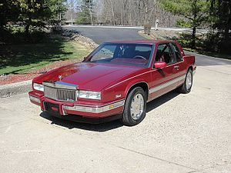
Brand cars class "Lux", owned by General Motors. Vehicles Cadillac are sold in more than 50 countries and territories primarily in North America. Currently Cadillac is the second oldest American automobile manufacturer after the "Buick" and one of the oldest automobile brands in the world. Date of Foundation: August 22, 1902
The game with the audience
Name the make of car
I wanna share my dreams Wanna share with you On the wings of love Like dreamers do Touch your heart — You're the queen of broken hearts Oh we are daytime friends and nightime fools Wanna play this game And break the rules Tears of love are frozen tears Geronimo's ………. Is making all girls turn mad Geronimo has a heart — oh it's a drag Geronimo's ……….. Is making all girls turn sad Geronimo has a heart — oh it's a drag Geronimo's ……….. it's tossing oh in your head It's tossing — it's turning It's burning — it makes you mad Geronimo's ………… Oh baby I'll hold you back It's tossing and turning It’s burning — it makes you sad I'm looking through the eyes The eyes of love Made a fool of me — can't get enough
Touch my heart — boulevard of broken dreams Another time for love — other place to be Don't let him take your love Your love from me Tears of love are frozen tears Geronimo's ……….. Is making all girls turn mad Geronimo has a heart — oh it's a drag Geronimo's ………… Is making all girls turn sad Geronimo has a heart — oh it's a drag Geronimo's ………… it's tossing oh in your head It's tossing — it's turning It's burning — it makes you mad Geronimo's …………. Oh baby I'll hold you back It's tossing and turning I'ts burning — it makes you sad Geronimo's ………… Is making all girls turn mad
Geronimo has a heart - oh, it’s a drag.

Slide 19
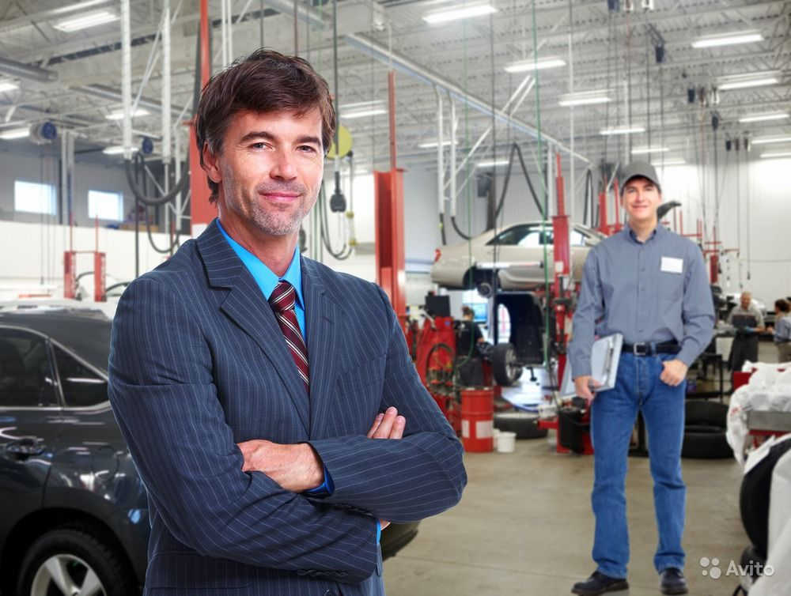
- Good morning, sir. I have come for a 15 thousand kilometers servicing. I have an appointment for 10 a.m.
- OK. Please, drive your car into the garage… Let me check the car and diagnose all possible problems…
- I’ve got some problems . I’ve noticed that the clutch is very noisy when I change gears.
- I see. The plate must be worn out. But it’s a normal thing at this mileage.
- Can I get it repaired today too?
Yes. Three hundred dollars and come back in four hours.
Thank you.

Slide 20
Доброе утро, сэр. Я приехал на техосмотр с пробегом 15 тыс. км. У меня запись на 10 утра.
- OK. Пожалуйста, заезжайте в гараж… Давайте я проверю авто и проведу диагностику всех возможных проблем…
- У меня есть некоторые проблемы. Я заметил, что сцепление очень шумит при переключении передач.
- Понятно. Должно быть, диск стерт. Но это нормально при таком пробеге.
Его можно отремонтировать сегодня?
Да. 300 $ . Приходите через четыре часа.
Спасибо.

Slide 21
- Hello
- Hello. How may I help you?
- I have a problem with my transmission. When I try to put it into reverse, there’s a harsh grinding.
- You’ll have to leave the car with us. We will do a diagnostic check on it to find out what the problem is.
- When will you do it?
- Today. I’ll call you in about four hours.
OK. Thank you. Goodbye.
Goodbye.

Slide 22
- Здравствуйте. - Здравствуйте. Чем могу помочь? - У меня проблема с коробкой. Когда я включаю заднюю передачу, раздаётся резкий скрежет. - Вам придется оставить машину у нас. Мы сделаем диагностику, чтобы выяснить, в чем проблема. - Когда вы сможете это сделать? - Сегодня. Я позвоню вам в четыре часа. ОК. Спасибо. До свидания. До свидания.

Slide 23
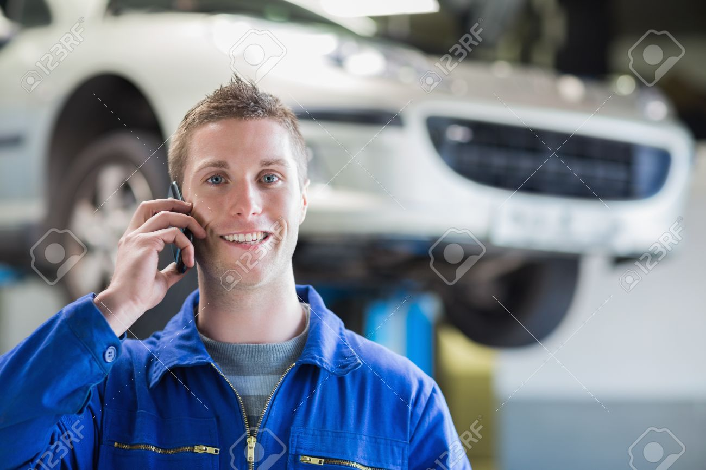
- Hello. This is Tom Collins from repair shop. We have done a check on your car. We need to replace the transmission.
- That’s too bad.
- We will order the new transmission and put it in for you. With labor and parts it will cost three thousand dollars.
- How long will it take?
Three or four days. I’ll call you as soon as we’re done.
Thank you. I will wait for your calling.
Goodbye.
- Goodbye.

Slide 24
- Здравствуйте. Это Том Коллинз из автосервиса. Мы сделали диагностику вашей машины. Нужно менять коробку передач. - Очень плохо. - Мы закажем новую коробку и поставим её. Работа вместе с запчастями будет стоить три тысячи долларов. - Сколько времени это займет? Три или четыре дня. Я позвоню вам, как только мы закончим. Спасибо. Я буду ждать вашего звонка До свидания. - До свидания.

Slide 25
Questions for all. Вопросы для всех. Name the make of car

Slide 26
Buick - formally the Buick Motor Division, is an American automobile division of the American manufacturer General Motors (GM). 1903

Slide 27
Pontiac was a brand of automobiles manufactured and sold by General Motors (GM) 1926 -2009

Slide 28
Dodge is an American brand of cars, minivans, and sport utility vehicles manufactured by FCA US LLC (formerly known as Chrysler Group LLC) 1900

Slide 29
Chevrolet colloquially referred to as Chevy and formally the Chevrolet Division of General Motors Company 1911

Slide 30
FCA US LLC, also known as simply Chrysler is an American automobile manufacturer 1925

Slide 31
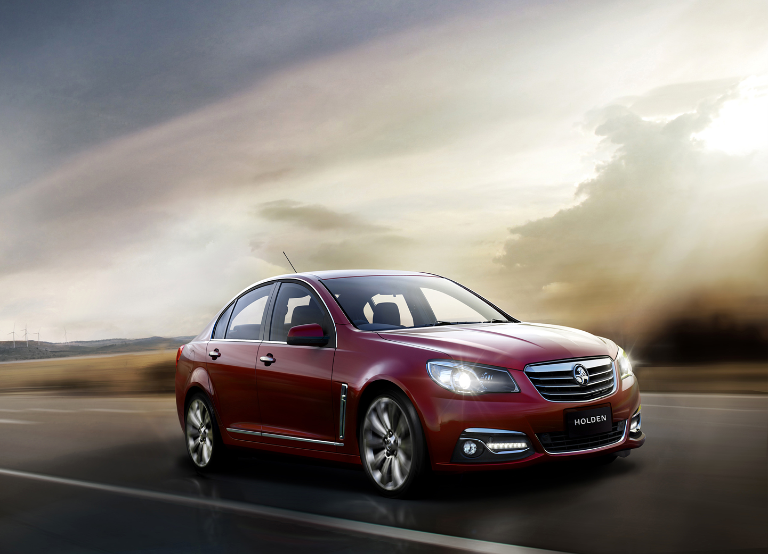
GM Holden Ltd, commonly known as Holden, is an Australian automaker that operates in Australasia and is headquartered in Port Melbourne, Victoria. The company was founded in 1856

Slide 33
Список литературы и интернет ресурсов:
https://ru.wikipedia.org/wiki/
http://www.perfekt.ru/dictionaries/tech.html
http://s-english.ru/dialogi/at-the-car-servicu-station
http://subscribe.ru/group/razgovornyij-anglijskij-uchim-yazyik-vmeste/8822904/
https://yandex.ru/images/
http://best-muzon.com/online/
Сборник устных тем для подготовки к ГИА 5-9 классы автор Ю.А. Смирнов. «Просвещение»

