Slide 1
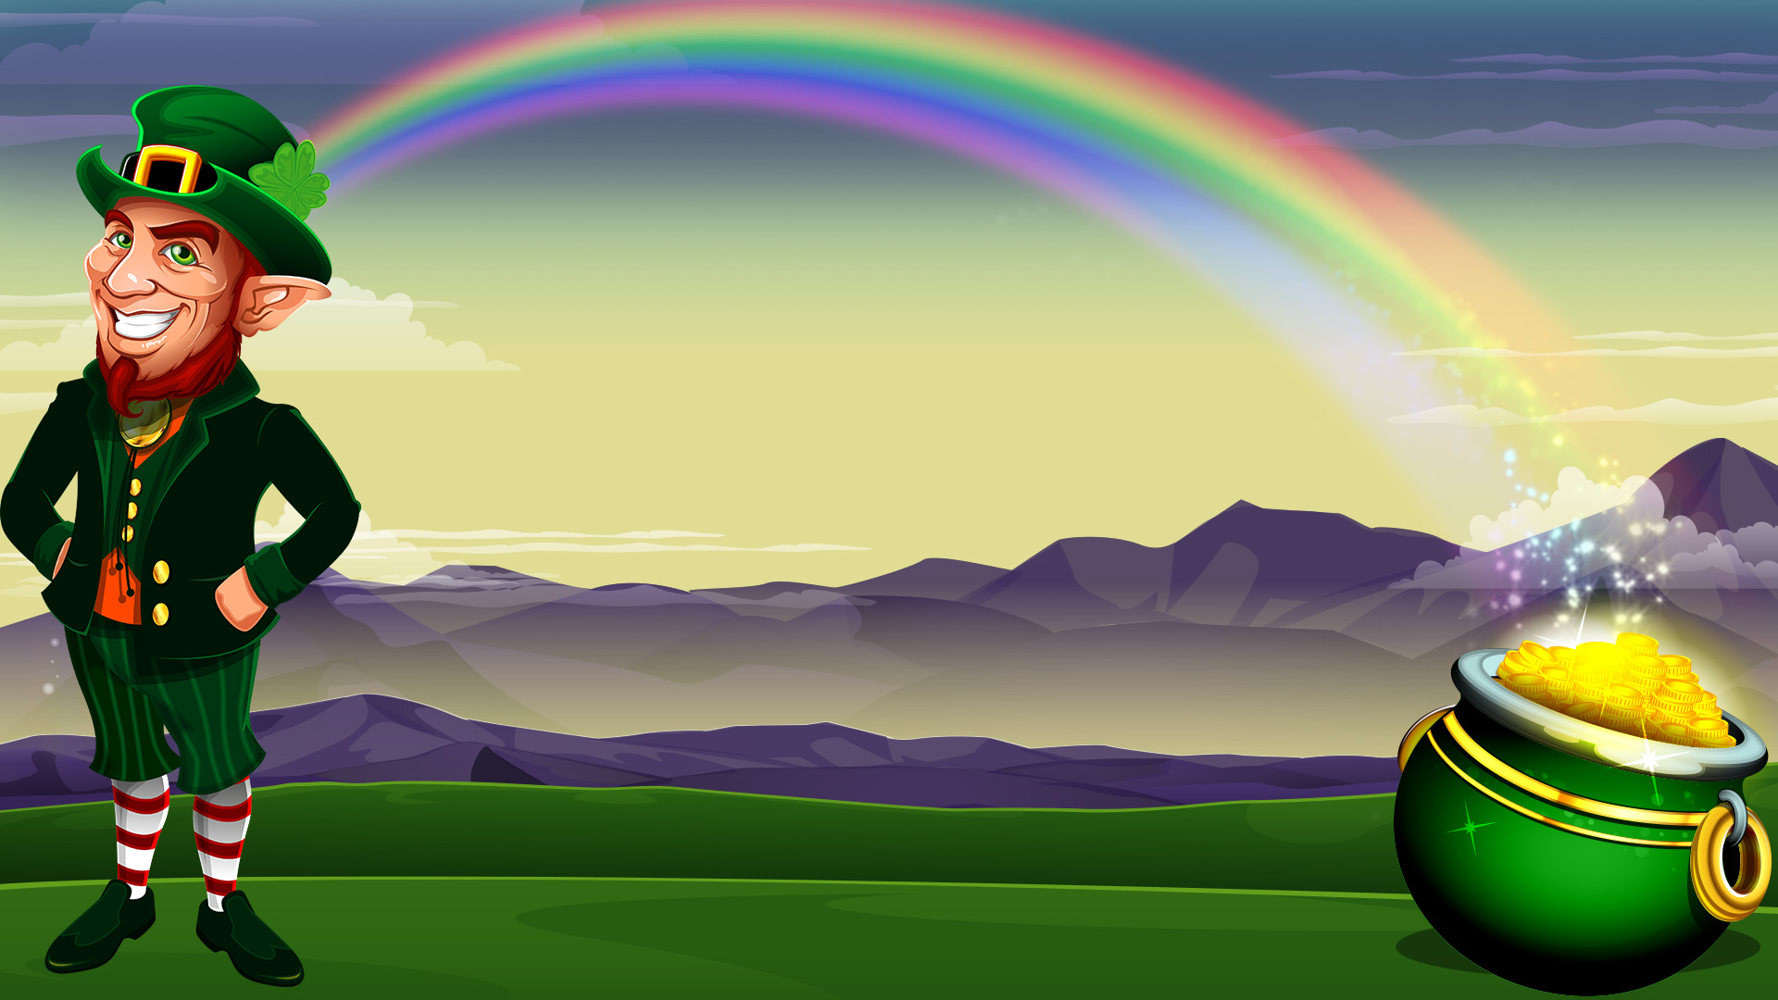
Leprechaun
Презентацию подготовил : Показаченко Андрей

Slide 2
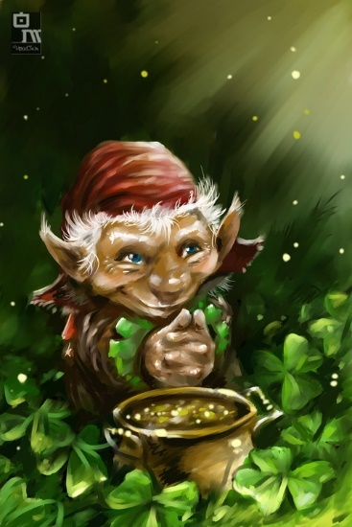
Leprechauns are mythical creatures of Irish folklore. It is noteworthy that the image of this character is actively used by many countries to attract tourists. It is not only that leprechauns actually exist and there are facts that seem to support this rumor, but also unusual about the role of men in culture. There are parks, museums, alleys and Lada holidays devoted to these characters.

Slide 3
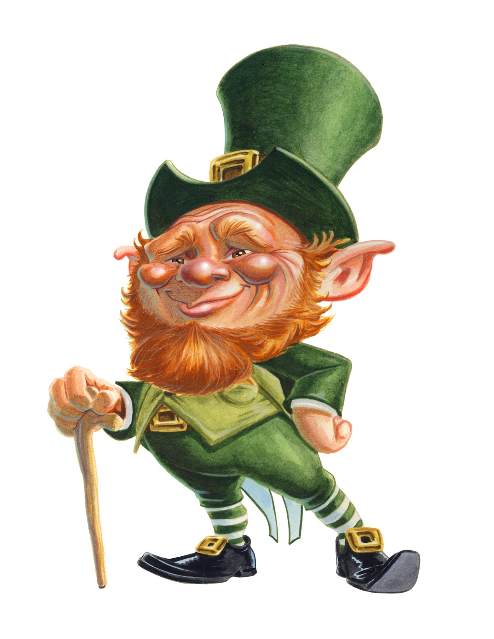
In accordance with Irish folklore, you can make a brief description of the leprechaun, shows all its distinctive features. This creature resembles a small human growth and usually advanced age. The character is portrayed in the costume is primarily green, and sometimes red. Leprechauns always wear hats to match the outfit. Leprechauns live in the mountains of Ireland, however, quite often nests in basements wine cellars or bars. This is due primarily love characters to alcoholic beverages. By the way, every leprechaun always carries a flask and smokes a pipe.
The image of the leprechaun

Slide 4
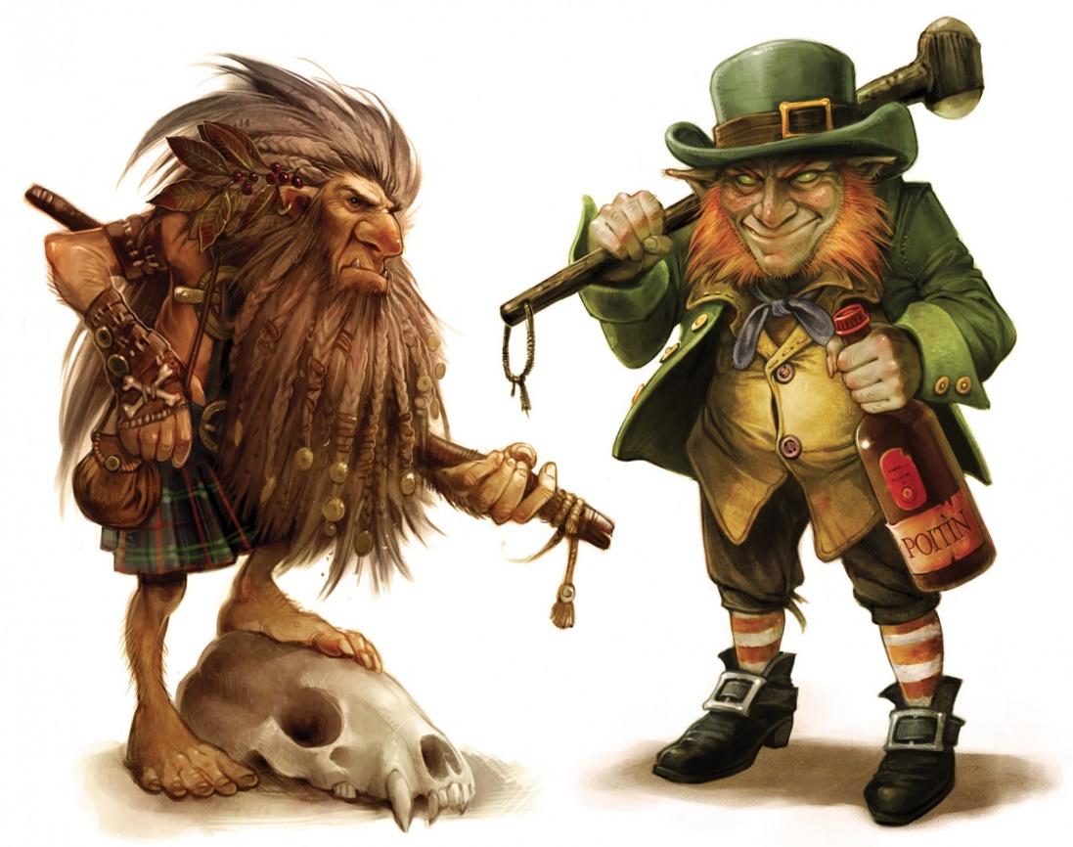
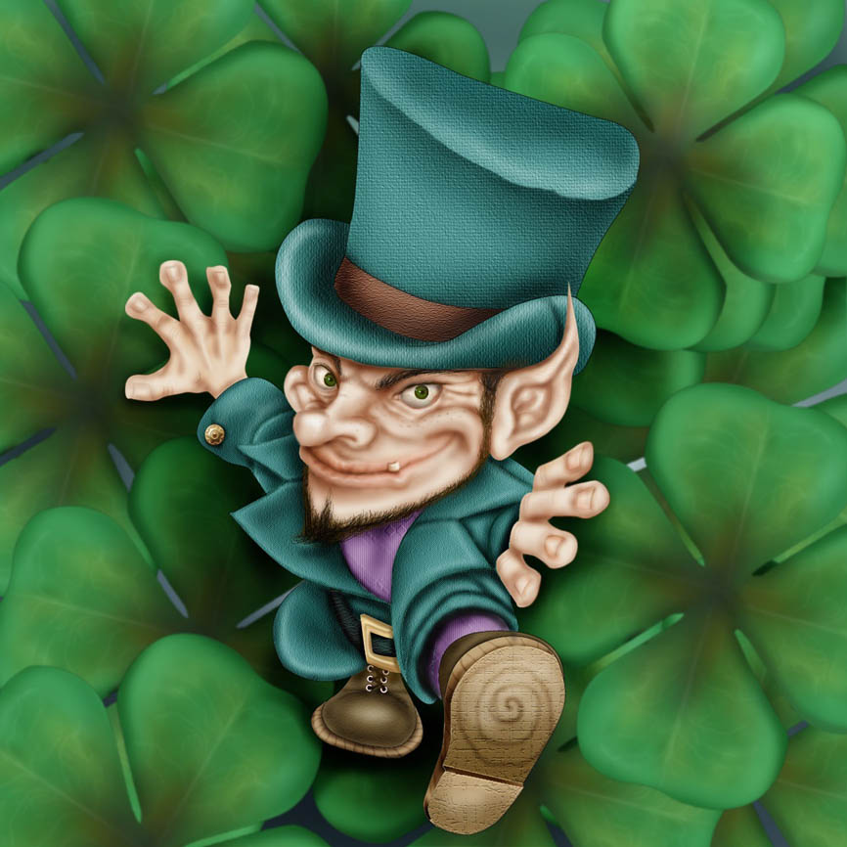
The Irish gnomes have their own profession – they bashmachnik. In some sources referred to information that leprechauns make shoes for other mythical creatures. The main character traits of these characters – cunning, deceit, a tendency to deceit and cowardice simultaneous. Leprechauns – the guardians of ancient treasures. Each creature has a bag or jug with gold and jewels, they always carry two wallets with silver and gold ruble. The silver coin is always returned to the owner, but turns into a Golden leaf. These RUB leprechauns deceive people. It is believed that at night these are the characters that go on residential houses and chip pieces from gold coins, thus replenishing their capital.

Slide 5
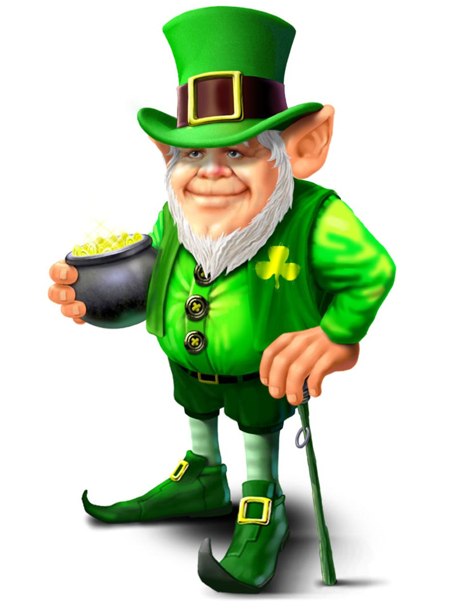
St. Patrick, the patron Saint of Ireland. The holiday, devoted to this character, for the Irish is considered to be the most fun day of the year. According to Irish legend, St. Patrick brought to Ireland to Christianity and defeated the evil serpent who inhabited the island. In addition to the cunning and guile, leprechauns and have good quality. The characters have a cheerful disposition, fond of jokes and fun. The heroes of St. Patrick's Day they began almost by accident. The fact that the image of the spiritual preacher is pretty harsh, and for the wedding party need more funny characters. So leprechauns and "made friends" with Saint Patrick. The holiday is celebrated on March 17. On this day, on the streets of Ireland you can meet a huge number of people dressed as leprechauns. Enjoy a true Irish parades and processions.
St. Patrick's Day

